Slide 1

Developing skills through the UEA Award for SU candidates
Natalie Freeman
UEA Award Manager
uea.ac.uk/award

Slide 2
This session
What is the UEA Award?
Reflecting on candidate-based activities
Reflecting on attributes developed
Using the ‘CARL’ model to talk about your achievements
How to access support

Slide 3
How the UEA Award can help you
Realise quite how much you already do
Understand the various attributes (skills / capabilities) you have developed through taking part in activities
Learn how to showcase this to future employers

Slide 4
Award structure
Bronze – Online activities & quiz Submit CV
Silver – Activity reflections, Careers Adviser QQ, Workshop Video CV
Gold – Activity reflections, Careers Adviser GA, Reflection on Silver Award workshop, Submit CV Panel

Slide 5
How the UEA Award can help you
Realise quite how much you already do
Understand the various attributes (skills / capabilities) you have developed through taking part in activities
Learn how to showcase this to future employers

Slide 6




Activities/experiences
Notes:
4 categories
Academic Activities
Stuff you do as part of your course – presentations / essays / group work / projects
Work related
Paid work and volunteering off campus
Career Management
Attending events at CC
Appointments
Mentoring
Reflection
Campus and personal
Volunteering on campus
Blog
Enterprise
Online learning

Slide 7
What do you already do?
Academic | Work-related | Career Management | Campus and Personal
Y1 formative | Part-time bar job | Careers adviser appointment | Candidate social media campaign
Seminar presentation | Work shadowing | CareerCentral CV workshop | Attend candidate briefing
 |  |  | Take part in candidate UEA Award workshop
Notes:
Opportunity for students to note down their current activity under the Award categories

Slide 8
How the UEA Award can help you
Realise quite how much you already do
Understand the various attributes (skills / capabilities) you have developed through taking part in activities
Learn how to showcase this to future employers

Slide 9








Attributes and skills

Slide 10
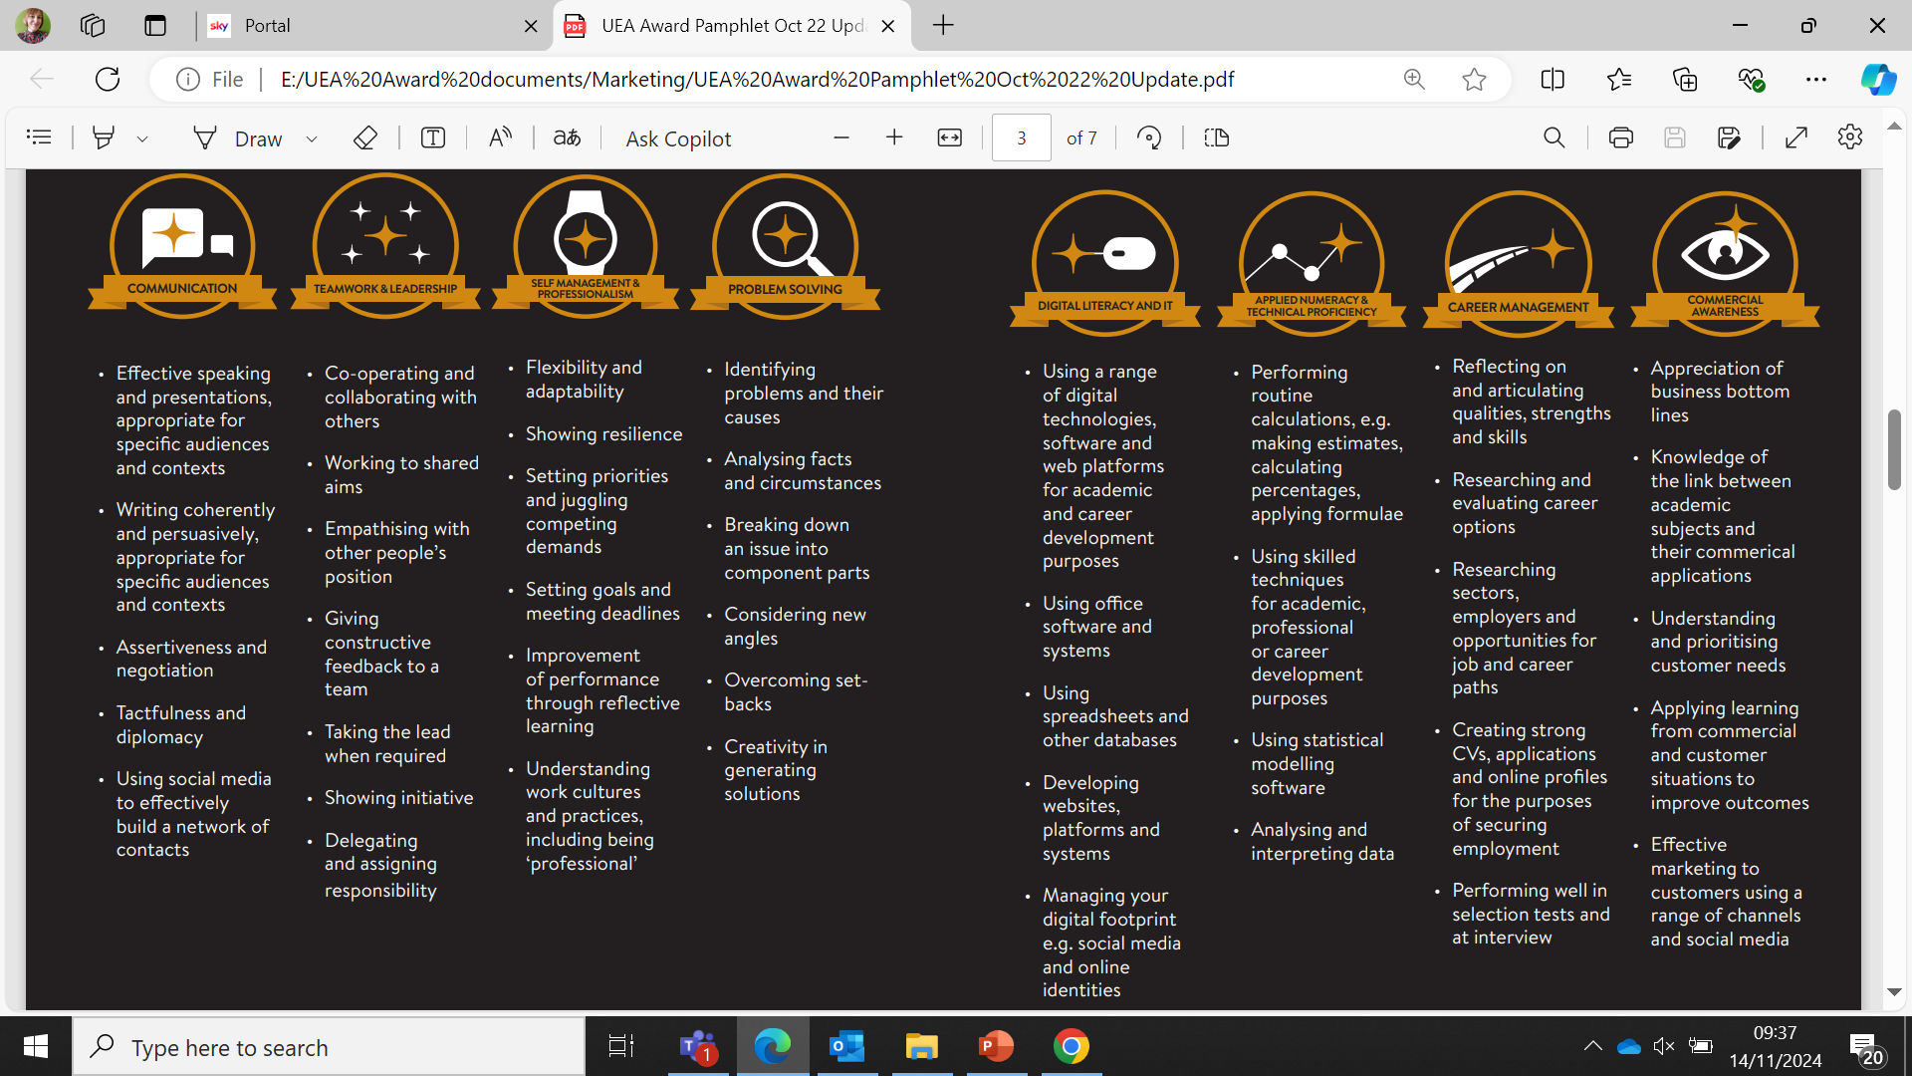

Slide 12
Effective speaking and presentations, appropriate for speciﬁc audiences and contexts
Writing coherently and persuasively, appropriate for speciﬁc audiences and contexts
Seeking clariﬁcation when unclear
Sensitivity to others
Assertiveness and negotiation
Tactfulness and diplomacy
Showing the conﬁdence to network effectively and for speciﬁc purposes
Using social media effectively to build networks of contacts

Slide 13
Linking attributes to activities
Choose 1 or 2 activities from your list and consider which of the UEA Award attributes you have developed by taking part in that activity.
How exactly did you develop those particular attributes?
Are there any attributes you feel you have already developed well?
Are there any attributes which you feel are key areas for further development?

Slide 14
How the UEA Award can help you
Realise quite how much you already do
Understand the various attributes (skills / capabilities) you have developed through taking part in activities
Learn how to showcase this to future employers

Slide 15
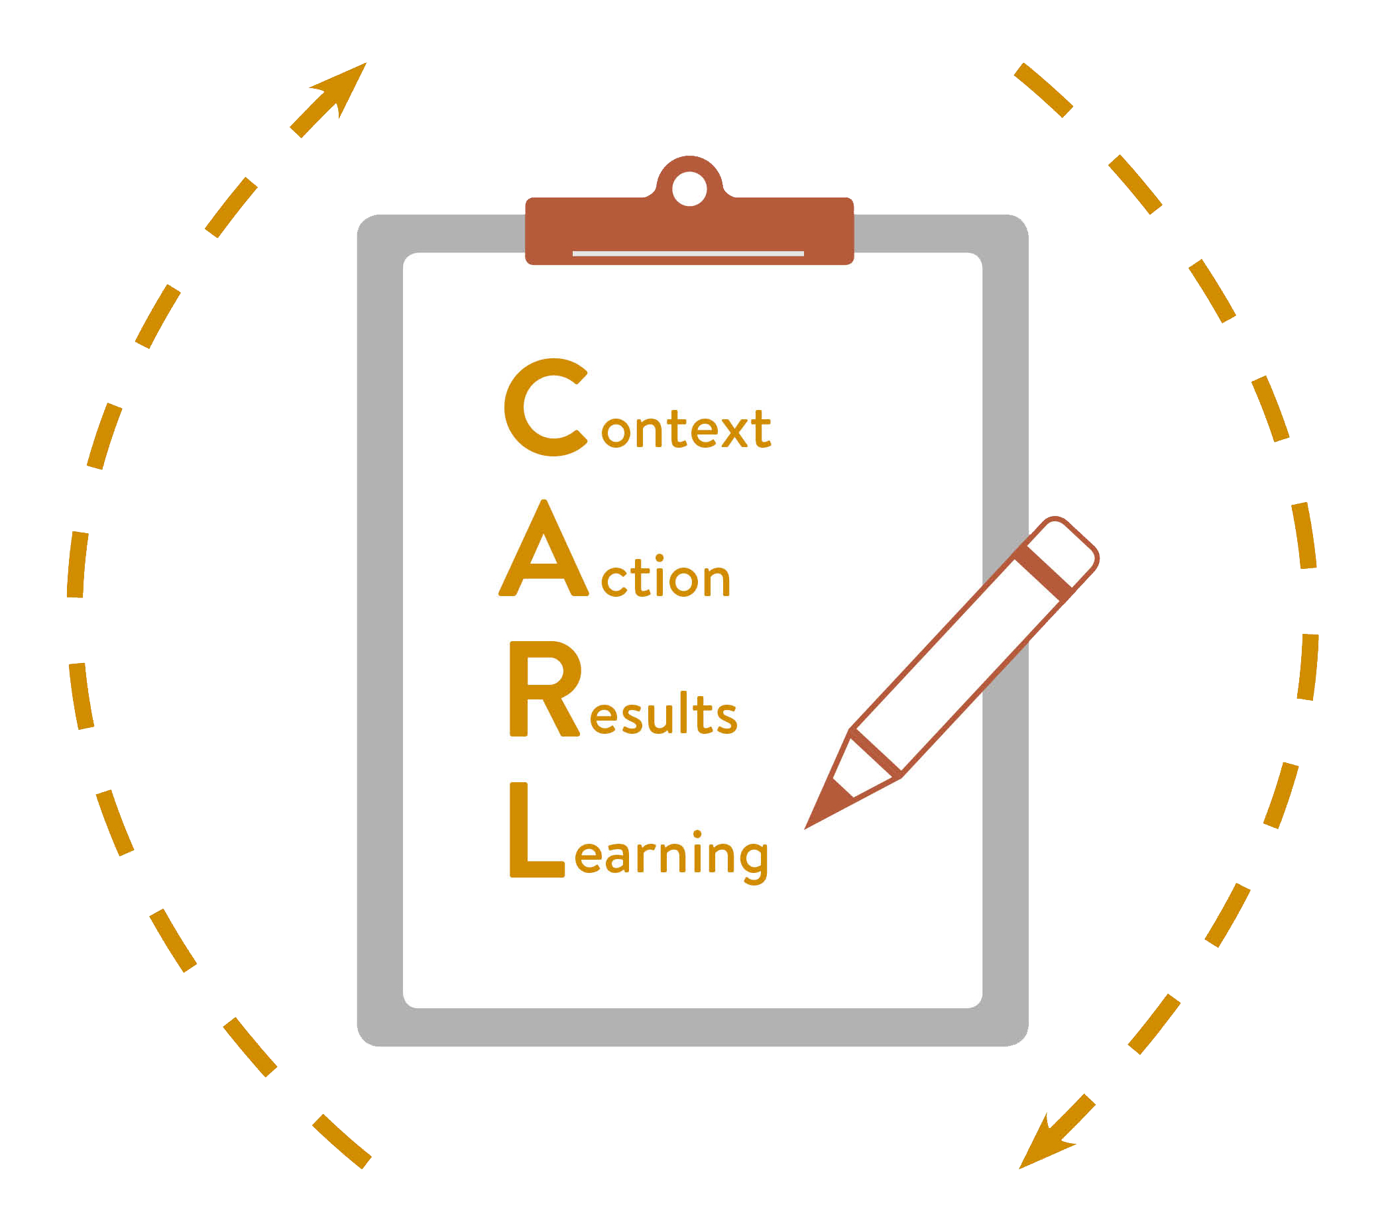
CARL Framework of Reflection
Notes:
Introduction to writing reflectively in ‘employer speak’

Slide 16
Example reflection using CARL
Context: As part of one of our modules, we were asked to prepare a group presentation for a formative assessment.
Actions: We had to organise our time, so I suggested that we set up a WhatsApp group to stay in touch and arrange when/where to meet. I booked us a room in the library and we agreed who would do what. I then went away, completed my research and made my slides.
Results: My slides were clear and well structured but I was so nervous I didn’t present very effectively.
Learning: I need to look up some strategies to combat nerves when presenting and practise my presentation beforehand.

Slide 17
In summary…
Record your achievements and gain recognition.
2. Build a great CV that does justice to your time at UEA.
3. Be in the know and take part in activities.
4. Gain recognition and feedback from employers.
5. Gain greater awareness of your strengths and areas for development.
6. Build confidence!
.
Notes:
Summary: We want to support you to build confidence and be able to recognise all that you have to offer.

Slide 18

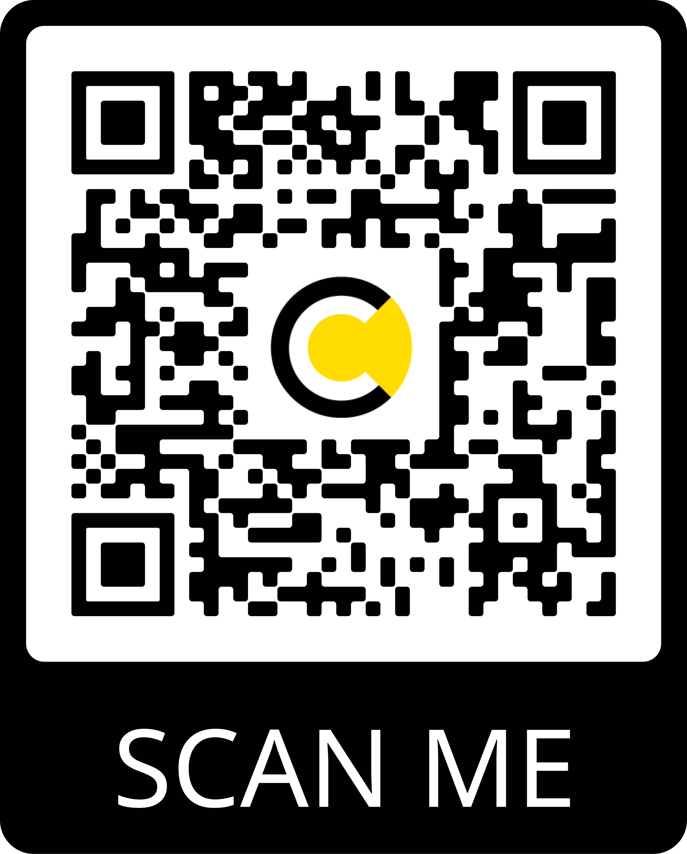
How do I sign up?
Any questions? Email the UEA Award team at award@uea.ac.uk
Notes:
Quote from employer about university skills awards.

