Slide 1





uea(su)
SOC Training

Slide 2









THE PICTURE GAME
Get in a line one in front of the other
The person at the back will have a picture. They must communicate it to the picture to the person in front of them
That person then describes the picture to the person in front of them, and so on until it reaches the front!

Slide 3


stands for...
SOC meets every month, about a week after Union Council
Student Officer Committee
A little bit about SOC
SOC is a place where you can represent the interests of the students you are elected to represent
5 full-time officers and 15 part-time officers
so...

Slide 4
WHY IS ATTENDANCE IMPORTANT?
MAKE SURE YOU COME ALONG!
The students who elected you will be represented in any decisions made
An opportunity to touch base with your fellow Officers and seek help for projects
If you miss three SOCs in a row without sending apologies, we will organise a conversation about how better we can support you in your role

Slide 5



Say ‘No’ to the calendar invite
How do I send apologies?
Email the meeting host and tell them you can’t make it
Let someone else in the meeting know you won’t be there

Slide 6

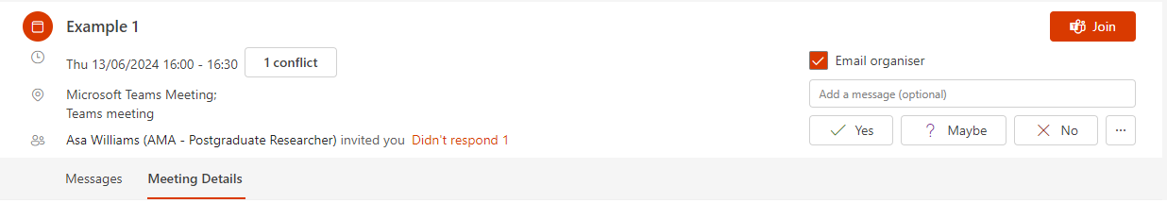





SIMPLY CLICK ‘YES’, ‘NO’ OR ‘MAYBE’
IT’S GOOD OFFICE ETIQUETTE, AND MAKES YOU COME ACROSS AS POLITE AND PUT TOGETHER
STAFF WILL LOVE YOU FOR THIS!

Slide 7

Email rewrite tasks
please stop emailing me
hi i missed this because i forgot and i am overworked
could you repeat what you said in your previous email so I don’t have to scroll up?
hey magda and beth not coming lol
can’t be arsed
will be at the bar three snakebites in so I can forget about my summatives (cry)
maybe see you next week probably not though i’ll be sure not to let you know
hey vice chancellor my guy
think what you’re doing is disgusting and shit
maybe don’t do that
yours unfaithfully
hi random student
I am the wrong person to contact as I do not care
save the tears for your pillow
dear head of science
can’t wait for our meeting lad just checking we’re still on yeah?

Slide 8
But seriously...
  It’s nice to be nice! Ask people how they’re doing, or what they’re up to at the weekend. It can feel a bit blunt if you just jump straight in and ask them for something.
  Make sure you put on your out of office when you’re away, with the date that you’ll be back so people know when they will hear from you.
  Try and get back to people as soon as you can, or let them know you got their email and you’re working on it!
  Emails should match the formality of the person you’re speaking to (if they use ‘dear’ then you should follow suit, etc)
  Capital letters, punctuation and grammar go a long way!

Slide 9


Break!

Slide 10






Remit Match-Up
can you find any similarities with another officer? could you work on campaigns around similarities together?
Hidden around the room are 42 slips of paper.
Each slip of paper contains a member of SOCs remit. Each PTO has two hidden remits. FTOs have 4.
You have 10 minutes to find all 42 slips of paper and place them under the position they belong to.
Go!

Slide 11




C&D!
A&O!
WCD!
A&O!
-Politically accountable for the Union’s communication and social enterprise teams
-Securing extra-curricular opportunities for students
- Strengthening and developing relationships between students and their local community;
-Being the primary Full Time Officer member of the Societies and Sports Executives.
- Being politically accountable for the Union’s welfare, advice and housing services;
-Developing campaign networks
-External Union Communications
-Training committee members of clubs, societies and student groups
- Extending, promoting and defending the rights of students
-Oversight of democratic processes to ensure they remain accessible
-Act as Publisher of Concrete, the student newspaper
-Being the main link to the NUS' Union Welfare Zone

Slide 12



UG!
PG!
Women’s Officer!
A&O!
Being the voice of UEA students on undergraduate education and access to the University;
Securing positive change for postgraduate UEA students in their education and research;
Engage with the University and other relevant organisations to achieve improvements for women students on the issues they face as women at university;
Being the primary Full Time Officer member of the Education Sub-Committee.
Working with members of University staff, through formal meetings and informal discussions, to achieve improvements in postgraduate education and research;
Be the Union’s delegate to the NUS Women’s Conference.
Working with members of University staff, through formal meetings and informal discussions, to achieve improvements in undergraduate education;
Having responsibility for developing, supporting and training postgraduate student representatives from across the University;
-Having responsibility for developing, supporting and training undergraduate student representatives from across the University;
Being the voice of UEA students on postgraduate education and research to the University;

Slide 13
Ethical Issues!
Environment Officer!
NPOs!
A&O!
Work on improving internal recycling facilities.
Work on maintaining and enhancing the ethical status of the Union and the University.
Fulfil all the duties as outlined in their manifesto, subject to Union policy and the strategic plan
Improve awareness of environmental issues and be responsible for relevant campaigns;
Improve awareness of ethical issues and be responsible for relevant Campaigns
Not undertake any duty that infringes upon or overlaps with the job descriptions of other officers of the Student Officer Committee.

Slide 14
LGBT+ Officer (Trans and NB place)!
LGBT+ Officer (Open Place)!
Students with Disabilities Officer (Physical Disabilities Place)
A&O!
Represent the interests of LGBT+ students and be their voice on the issues they face as LGBT+ students at university
Engage with the University and other relevant organisations to achieve improvements for LGBT+ students on the issues they face as LGBT+ students at university, with a focus on trans and NB students
Be the Union’s delegate to the NUS Disabled Students Conference.
Engage with the University and other relevant organisations to achieve improvements for students with disabilities on the issues they face as students with disabilities at university;
Engage with the University and other relevant organisations to achieve improvements for LGBT+ students on the issues they face as LGBT+ students at university.
Represent the interests of trans, NB and LGBT+ students and be their voice on the issues they face at university.

Slide 15
Students with Disabilities Officer (Invisible Disabilities Place)!
People of Colour Officer!
Mature Students Officer!
A&O!
Engage with the University and other relevant organisations to achieve improvements for students with disabilities on the issues they face as students with disabilities at university
Represent the interests of ethnic minority students and be their voice on the issues they face as ethnic minority students at university
Be the Union’s delegate to the NUS Mature Students Conference.
Represent the interests of mature students and be their voice on the issues they face as mature students at university
Be the Union’s delegate to the NUS Black Students Conference.
Be one of two officers,that represents the interests of students with disabilities and be their voice on the issues they face as students with disabilities at university
Support Students of Colour Ambassadors and their work when needed

Slide 16
Mature Students Officer!
A&O!
International Officers (Non-EU and EU)!
Black Student’s Officer!
Engage with the University and other relevant organisations to achieve improvements for students with disabilities on the issues they face as students with disabilities at university
Represent the interests of black students and be their voice on the issues they face as black students at university
Be one of two officers, that represents the interests of students with disabilities and be their voice on the issues they face as students with disabilities at university
Be the Union’s delegate to the NUS Black Students Conference.

Slide 17
Policy and Paperwork

Slide 18
the union is governed by two key documents
articles of association
bye-laws
  Governing document​
  Lays out fundamentals​
  Legally very important​
  Can be amended but requires sign off by Trustee Board and UEA
  Where most of the ​rules come from​
  Also a governing document​
  Can be amended with approval from Union Council ​
  Seek advice when planning an adjustment

Slide 19
important dates
close of agenda items
two weeks before council
DPC
one week and three days before council
chair of council/ceo briefing
one week and two days before council
education committee
union council
one week and one day before council
pg committee
one week before council
agenda is public
one week before council
soc
one week after council

Slide 20
important dates
close of agenda items
two weeks before council
DPC
one week and three days before council
chair of council/ceo briefing
one week and two days before council
education committee
union council
one week and one day before council
pg committee
one week before council
agenda is public
one week before council
you all need to be at these!
soc
one week after council

Slide 21
important dates
close of agenda items
two weeks before council
DPC
one week and three days before council
chair of council/ceo briefing
one week and two days before council
education committee
union council
one week and one day before council
pg committee
one week before council
agenda is public
one week before council
some FTOs need to be at these as well
soc
one week after council

Slide 22
Break!

Slide 23


Who’s who in the SU?

Slide 24

staff hierarchy
CEO
university/HE/governance/decisions
CEO
can anyone guess at some examples of who is in these roles at uea(su)?
Assistant Directors
strategic decisions
operational decisions and support
Heads of Department
operational delivery, advice and research
Managers
administration and delivery of events
Coordinators

Slide 25
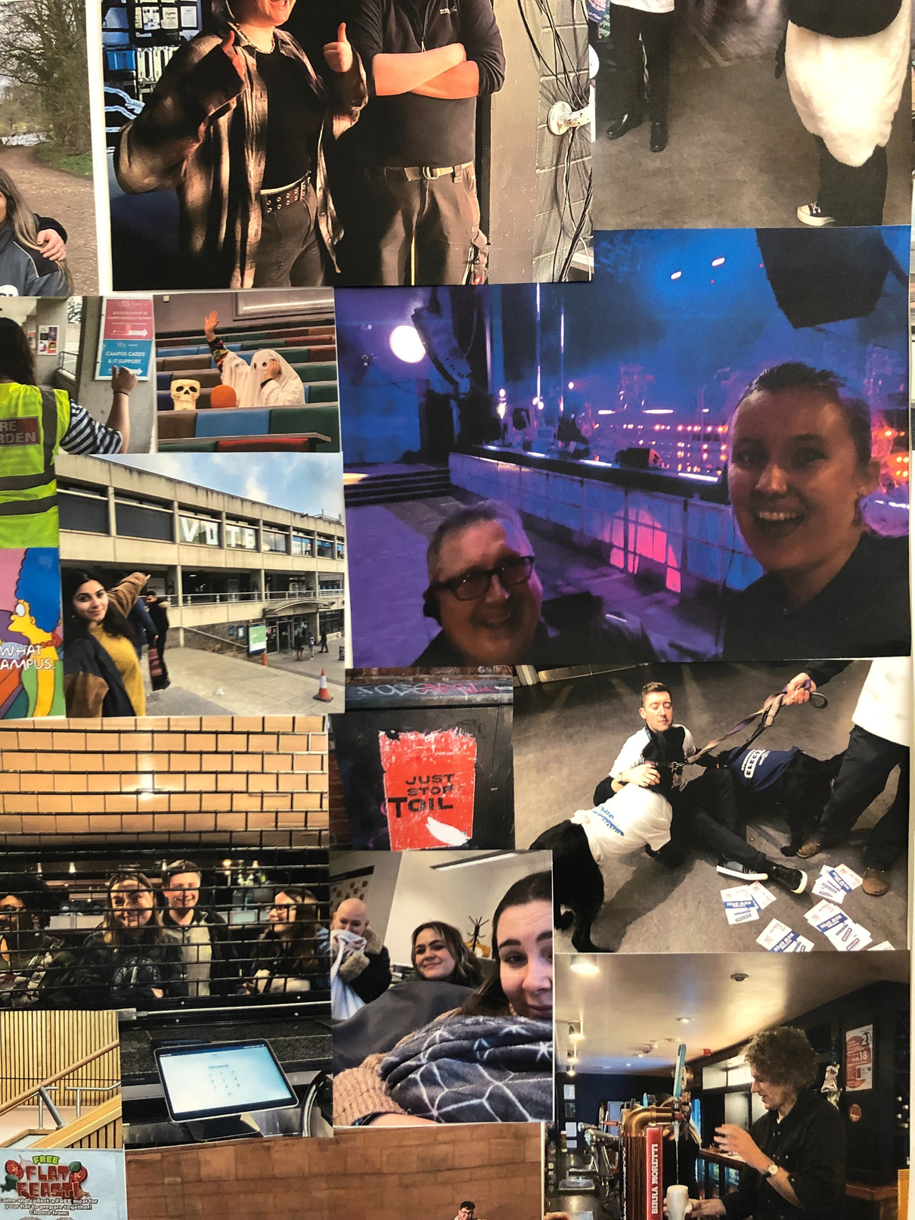
staff member match up
Around the room are faces from each department. We are going to give you some scenarios where you might need support from a department. Go stand by the people that can help you!

Slide 26



big issues
what are the big issues facing UEA students right now?
1
Mental Health provisions
Cost of Living Crisis/financial hardship
2
3
War in Palestine
4
Housing- both rental and rising house prices
5
“time-poor”, working around studies and su work

Slide 27
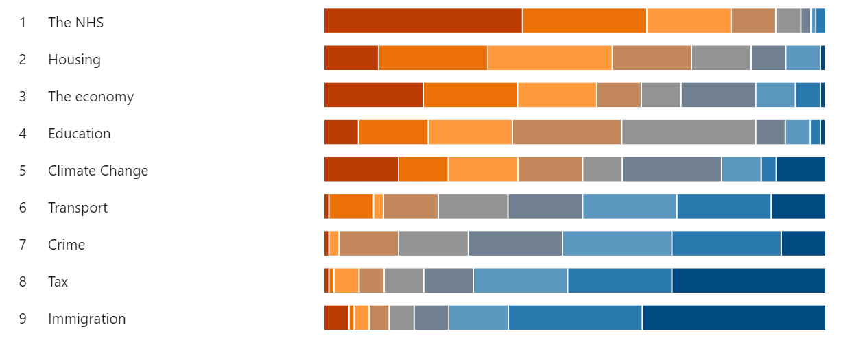
big issues
(the student manifesto data)
First Choice Last Choice
  The NHS
  Housing
  Economy
  Education
  Climate Change
  Transport
  Crime
  Tax
  Immigration

Slide 28

running campaigns
things to think about
do I need a campaign or can I resolve this informally?
have I let the Voice and Rep team know what I’m up to?
what support do I need from other officers, SU staff or someone else?
what is my aim?
Notes:
triage past the voice team

Slide 29


campaign aims - being clear
CAMPAIGN FOR A SOLUTION, NOT A PROBLEM
BE AS SPECIFIC AS YOU CAN
“Student Services waiting times are rubbish”​
“Improve Student Services waiting times”
“Improve Student Services waiting times”​
“Ensure that target waiting times of 10 days for x sessions are consistently met”
BE A POSITIVE VOICE
AND LINK IT TO YOUR CAMPAIGN
“Printing is so expensive, it’s fucking ridiculous”​
“Imagine what it would be like if each student had a set amount of printer credit”
“The university are actually reviewing their process for printing, do you have time for a 2 minute chat?”

Slide 30
TASK
can you reword the following as specific solutions?
EXAMPLE 1
EXAMPLE 2
The £20 graduation fee charge is an absolute pisstake, we're already being charged 9 grand a year.
The food prices on campus are getting ridiculous, it's completely unaffordable.
REMEMBER
  CAMPAIGN FOR A SOLUTION, NOT A PROBLEM
  BE AS SPECIFIC AS YOU CAN
  BE A POSITIVE VOICE
  KEEP YOUR AIM LINKED TO YOUR CAMPAIGN
  HOW ARE WE HOLDING THE UEA ACCOUNTABLE?

Slide 31
Break!

Slide 32


wellbeing and communicating respectfully
every role can come with occasional conflict but how it is dealt with can have an impact on the outcome and on the people involved
speak from your perspective
listen
rather than placing the blame on the other party, try to speak from your own perspective
e.g. ‘when you express those views, it makes me feel...’ or ‘when you behaved in that way, I felt...’
take the time to ensure the other party feels heard and understood
this makes sure that everyone feels valued, and can take the heat out of the moment
You are all politically equal!

Slide 33
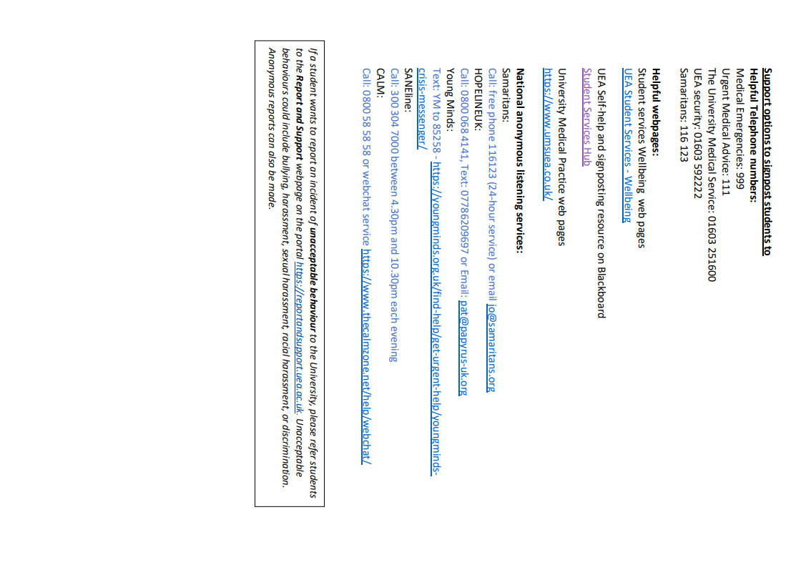
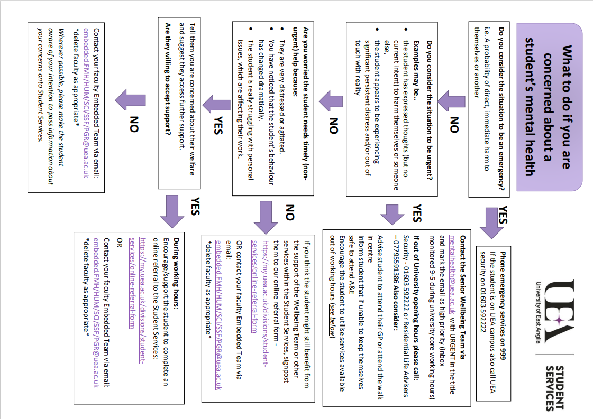

Slide 34
staff support
every officer has a designated staff support, who can provide guidance and admin help, and be a friendly face to chat to
(of course, all uea(su) staff are always happy to help!)
Welfare, Community and Diversity
Kathryn Redfern- Head of Advice and Welfare
Activities and Opportunities
Adam Roche- Head of Communities and Programme
Postgraduate
Yusra Khan- Assistant Director of Engagement
Undergraduate Education
Yusra Khan- Assistant Director of Engagement
Campaigns and Democracy
Mike Hill- Head of Voice and Representation
Non-Portfolio (x4)
Magda de Soissons and Beth Plant- Voice and Representation Coordinators
LGBTQ+ (x2)
Matt Cullum- Equality and Inclusion Coordinator
Students with Disabilities (x3)
Matt Cullum- Equality and Inclusion Coordinator

Slide 35
staff support
every officer has a designated staff support, who can provide guidance and admin help, and be a friendly face to chat to
(of course, all uea(su) staff are always happy to help!)
International (EU)
Matt Cullum- Equality and Inclusion Coordinator
International (Non-EU)
Vic Jackson- Student Events Programme Manager
Black Students
Beth Plant- Voice and Representation Coordinator
Students of Colour
Beth Plant- Voice and Representation Coordinator
Mature Students
Vic Jackson- Student Events Programme Manager
Environment Officer
Magda de Soissons- Voice and Representation Coordinator
Ethical Issues
Magda de Soissons- Voice and Representation Coordinator
Womens
Vic Jackson- Student Events Programme Manager

Slide 36
switching off
sometimes your roles can be very busy and feel all consuming- it’s important to know when and how to switch off
answer the questions below on two post it notes
what are your personal signals that you need a break?
what helps you switch off?

Slide 37


the office is YOUR space to use. walk in whenever you want! we have study spaces, spare desks, friendly faces and mediocre coffee
How can we help you feel more at home in your space?

Slide 38
ALSO we will be running a series of skills workshops e.g CV writing, networking, leadership development, job huntnig etc over the next few months to help with your professional development (Skills bootcamp!) so watch out for those emails and please do come along!

Slide 39

FEEDBACK FORMS

Slide 40


THANK
YOU!
su.voice@uea.ac.uk
remember that you are all invited to the Volunteer Picnic on Friday September 13th!

