Slide 1



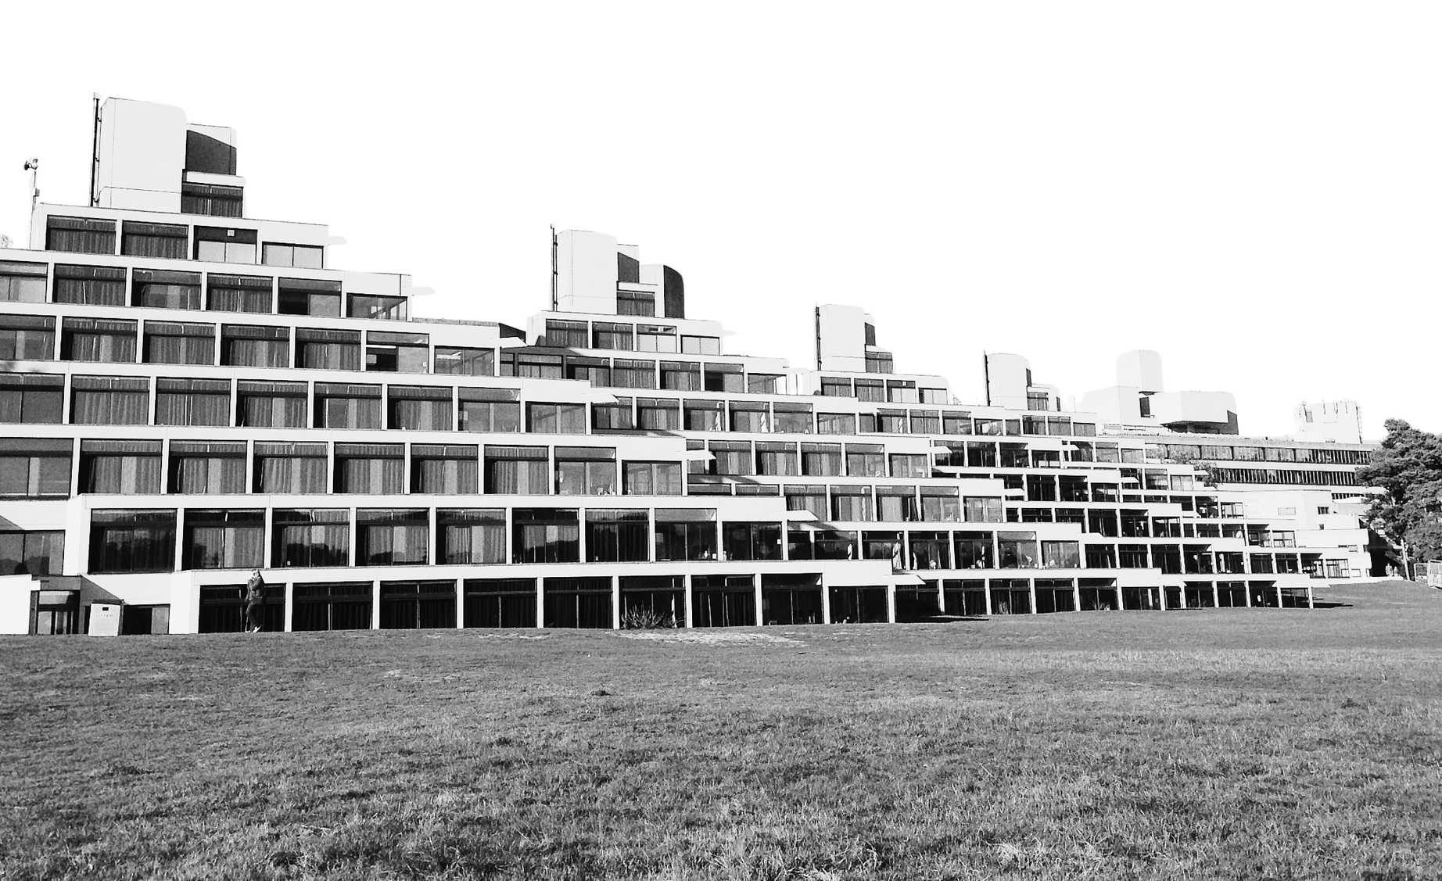

uea(su)
PTO Training

Slide 2















What’s a PTO?
Your role and office etiqutte
WHAT THIS TRAINING COVERS
Break
Employability
Networking
Trustee Boundaries
Liberation Months
Questions and Thank you!
How to handle SU crises

Slide 3


Icebreaker

Slide 4



what is a PTO?
think pair share

Slide 5
PTO
A&O!
you each have an individual member of staff who is your staff support which we will go through later
as a part-time officer, you are a volunteer for uea(su)
you have the same amount of political power as FTOs becuase you are all elected representatives
as volunteers for uea(su), you are greatly valued and appreciated members of the team- we couldn’t do what we do without you!
for PTOs, your studies must come first. you are students first, officers second!

Slide 6

PTO
A&O!
please come use the office whenever you like, you don’t have to ask at the desk, as it’s YOUR space! we have specific desks for you to use, and a lot of booths!
SOC is important as it allows us to touch base with you all, link up campaigns and make sure everyone is receiving the right support. funding requests and initial ideas usually go through SOC first, as the political leadership of the su
This role is flexible; you can work as much or as little as you like. We do ask though that you attend SOC and Union Council as frequently as you can. It helps everyone’s aims move further faster.

Slide 7






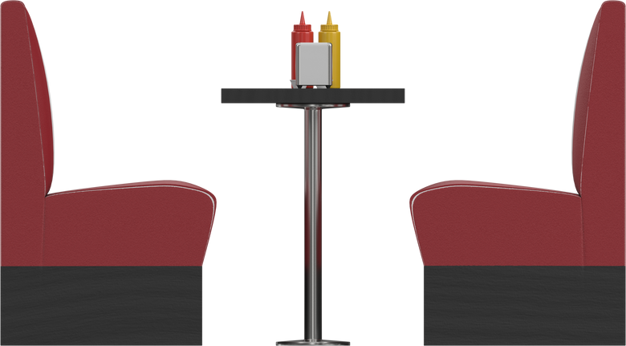

random storage corner
PTO
A&O!
HR
Finance
Marketing/Comms
Communities and Programmes
FTOs (and hot desks for PTOs)
booths- all yours!
Jumara
Venues
Voice
(icons, legends, besties)
Advice

Slide 8
A&O!
questions?

Slide 9
A&O!
break!

Slide 10



Employability
what skills do you think you’ll gain as a PTO?
making the most of your skills in a tough job market
how can you translate these onto your CV?

Slide 11
spend a couple of minutes considering with the person next to you (or in chat, if online) what skills you gained during the election period?
e.g. Drive, independence, practical skills

Slide 12
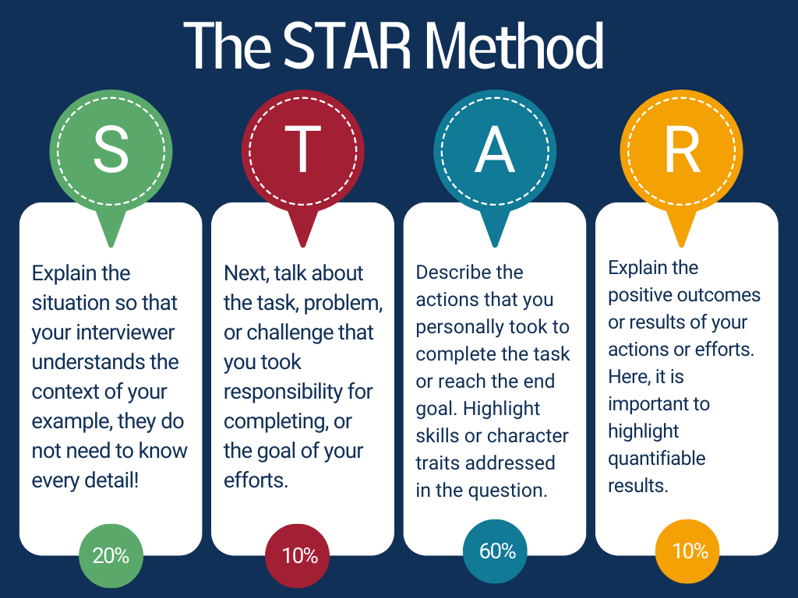
STAR method of CV paragraphs

Slide 13


networking
WCD!
A&O!
what is the National Union of Students?

Slide 14
networking
WCD!
A&O!
NUS holds conferences on various topics, networking events and provides support
uea(su) sends delegates to most NUS conferences- look out for the opportunity to go if you’d like further networking options

Slide 15

liberation months
if your remit is related to a liberation month, we would love to have you involved in the planning for that month from the su end, in addition to your own wonderful plans
we may contact you, but feel free also to get in contact with us!

Slide 16



support
your staff support is your first port of call but all members of staff will always be happy to help
you are a student first and a PTO second. Look after yourself, and reach out if you need support.

Slide 17


THANK
YOU!
union.hr@uea.ac.uk

